Slide 1
Audio process for Arrhythmia detection
Yifei Che, Liying Zhu, Qihua Gong

Slide 2

CONTENTS
Introduction
Literature Review
Proposed Methodology
Dataset
Pre-processing
Feature Extraction
Classification
Results and Discussions
Conclusion and Prospects

Slide 3
Motivation
Failing to diagnose someone who might have a serious heart condition is very alarming. Our main motive was to develop a Machine Learning Algorithm that can classify between a normal person and a person with Arrhythmia. This algorithm will help in early classification of Arrhythmia disease.

Slide 4
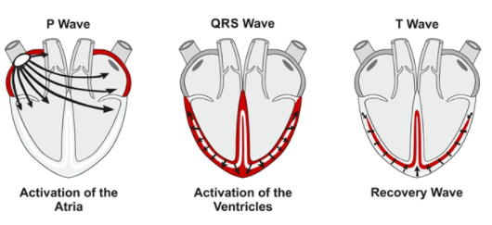
Cardiovascular Disease
CVD is the greatest global health challenge with
high mortality and morbidity.
CVD is cause of approximately 17,689 thousand deaths, with crude death rate of 240.9
By 2030 number of deaths due to CVD are expected to be more than 23.3 million per annum.

Slide 5
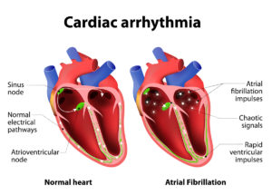




Arrhythmia (Disease Related to Heart)
Problem with the rate or rhythm of your heartbeat.
Your heart beats too quickly, too slowly, or with an irregular pattern.
If heart beats faster than normal, it is called tachycardia.
heart beats too slowly, it is called bradycardia
37,574 million cases
$4000-$5000
Cost to family
2 years life expectancy on average
Cure
Available

Slide 6
Literature Review
Mitra et al. proposed a three-stage technique based on stationary wavelet transform for noise reduction, and classification.
Huang et al. introduced the empirical mode decomposition to analyze non-linear and non-stationarity in ECG signals.
Dragomiretskiy and Zosso proposed the variational mode decomposition (VMD) model.
Maji et al. proposed the VMD technique using frequency domain features.

Slide 7
Literature Review
Osowski et al. used SVM classifiers to classify 13 types of heart rhythm and achieved a high classification accuracy.
The cross-wavelet transform (XWT) based method has been used for classifying normal and abnormal cardiac beats.
DWT and dimensionality reduction methods have been used in the past for classifying five classes of arrhythmia.
Martis et al made use of HOS cumulants features extracted with principal component analysis.

Slide 8
PROPOSED METHODOLOGY
Dataset
Pre-processing
Feature Extraction
Classification

Slide 9
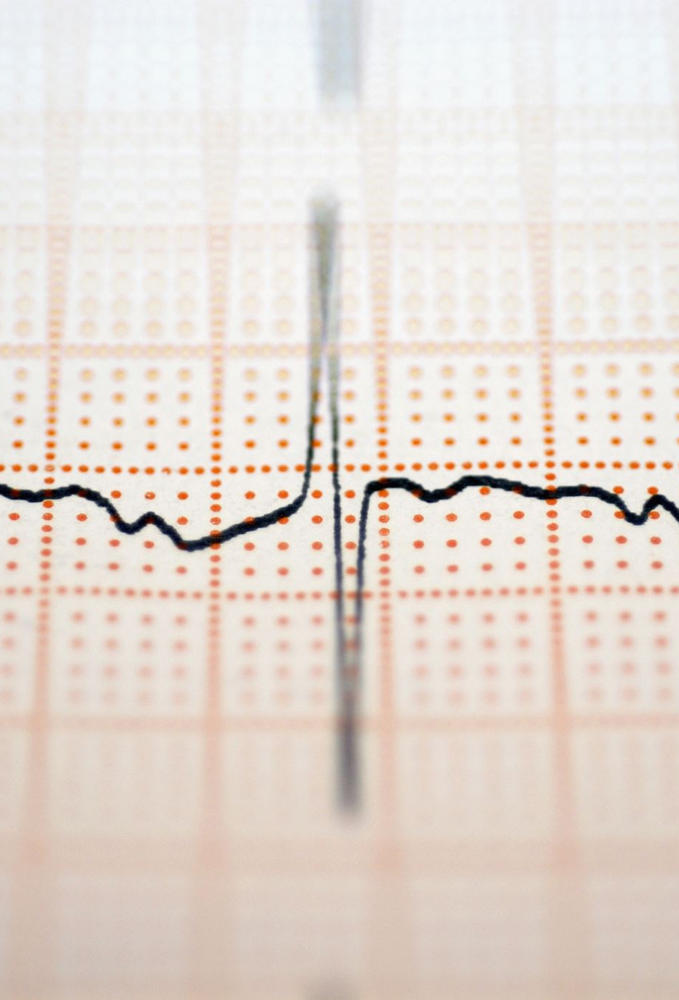
Dataset
Dataset was obtained from PhysioNet/CinC Challenge 2016: Training Sets. Liu et al. An open access database for the evaluation of heart sound algorithms. https://www.ncbi.nlm.nih.gov/pubmed/27869105
Heart sound recordings were sourced from several contributors around the world. The Challenge training set consists of five databases (A through E) containing a total of 3,126 heart sound recordings, lasting from 5 seconds to just over 120 seconds.

Slide 10
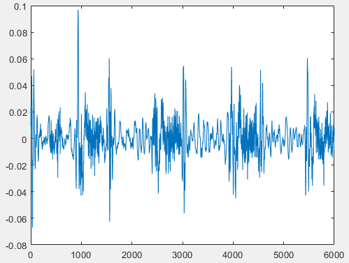
Preprocessing
Wavelet Denoising was used for removing noise from heart signals.
Method of analysis that:
uses time-frequency to select an appropriate frequency band based on the characteristics of the signal.
Abnormal Signal with noise

Slide 11
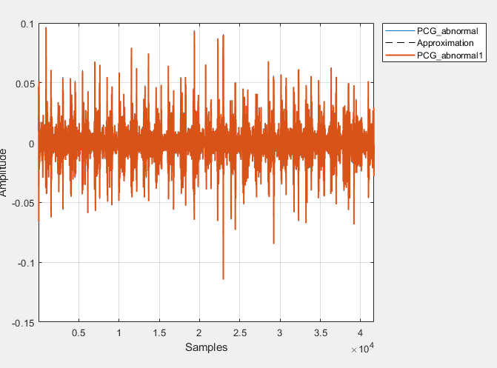
Abnormal Signal without Noise

Slide 12
FEATURE EXTRACTION
TIME DOMAIN
FEATURES
Mean
Median
Standard Deviation
Mean Absolute Deviation
Quantile 25
Quantile 75
Signal IQR
SPECTRAL FEATURES
Sample Skewness
Sample Kurtosis
Signal Entropy
Spectral Entropy
Dominant Frequency
Value
Dominant Frequency
Magnitude
Dominant Frequency
Ratio
14
Mel-Frequency Cepstral Coefficients (MFCC)

Slide 13
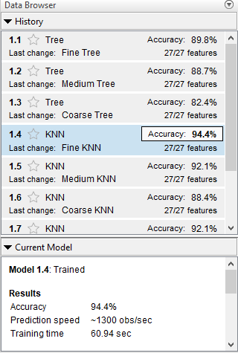
Classification
We implemented various classifiers including SVM,KNN, Tree classifier, Random Forest etc. but selection of classifier was based on accuracy. We were getting the best accuracy from KNN classifier. So, we decided to proceed with KNN classifier.

Slide 14

K-Nearest Neighbour
The algorithm can be used to solve both classification and regression problem statements.
Supervised machine learning algorithm.
The number of nearest neighbours to a new unknown variable that has to be predicted or classified is denoted by the symbol ‘K’.
It’s a distance-based approach.

Slide 15

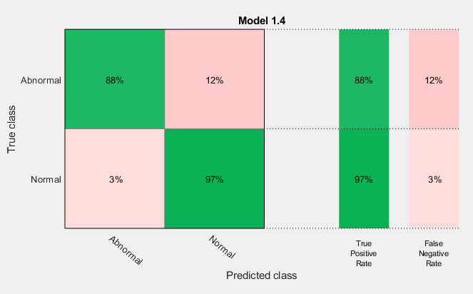




RESULTS
$Sensitivity=\frac{TP}{TP+FN}×100$
$Specificity=\frac{TN}{TN+FP}×100$
$Accuracy=\frac{TP+TN}{TP+TN+FP+FN}×100$
$F−measure=\frac{2TP}{2TP+FP+FN}×100$
Confusion Matrix of KNN classifier

Slide 16
True Positive (TP): Subject is having arrythmia and is predicted correctly.
1
False Negative (FN): Subject is having arrythmia but is predicted incorrectly.
2
True Negative (TN): Subject is Normal and is predicted correctly.
3
False Positive (FP): Subject is Normal, but is predicted incorrectly
4

Slide 17
Conclusion
From results, there is still a need for improvements in classifiers performance.
Because failing to diagnose someone who might have a serious heart condition is very dangerous.
So, in future we would like to work to improve our model performance bychoosing some other preprocessing technique, some selective features and a different classifier in future to improve our results.

